Slide 1


DATA SCIENCE | PROJECT 2025
About
Home
Contact
CONTENT-BASED
MOVIE RECOMMENDER
WHAT DOES THE CONTENT SAY?
A Natural Language Processing Approach to Movie Recommendation
By Muhammad Fakhri Azhar | Data Science

Slide 2



DATA SCIENCE | PROJECT 2025
INTRODUCTION
In today’s digital age, the vast array of entertainment content, especially movies, has grown tremendously, often making it challenging for users to find films that suit their tastes. A recommendation system serves as a valuable tool to help users discover relevant and engaging movies based on their preferences. One effective strategy for developing such a system is to leverage Natural Language Processing (NLP), which can comprehend and analyze descriptive data about movies, including synopses, genres, cast, and production teams. By using this content-based approach, the system can deliver more tailored and appropriate movie suggestions without depending on user interactions.
View others project on my GitHub Repository: https://github.com/mfakhriazhar

Slide 3

INTRODUCTION
DATA SCIENCE | PROJECT 2025
BACKGROUND
PROBLEM STATEMENT
URGENCY
With the growing number of movies each year, users need a recommendation system to find suitable films. Utilizing Natural Language Processing (NLP), the system can analyze movie content and characteristics for more accurate suggestions.
Content-based recommendation systems help users find movies more quickly and relevantly, and promote computational efficiency to be applicable in various device conditions.
How to build a content-based movie recommendation system using NLP?
View others project on my GitHub Repository: https://github.com/mfakhriazhar

Slide 4

DATA SCIENCE | PROJECT 2025
PROJECT GOALS
Data Preprocessing: Clean movie data by processing text, addressing missing values, and selecting relevant columns.
Feature Extraction: Use TF-IDF to convert text information (overview, genres, cast, crew) into numerical representations.
Content-Based Recommender System: Calculate movie similarities with Cosine Similarity for recommendations.
Optimize Computation: Use a random subset of data for similarity calculations to maintain efficiency with large datasets.
View others project on my GitHub Repository: https://github.com/mfakhriazhar

Slide 5
ROADMAP
DATA SCIENCE | PROJECT 2025
Data Understanding
Data Preprocessing
Feature Engineering
Text Vectorization
Understand the data structure and identify relevant fields for the recommendation system.
Merging datasets, preparing important text columns for NLP, cleaning and parsing columns.
Combine key features and perform Text preprocessing.
Using TF-IDF Vectorizer to convert text into numeric vectors.
Recommender System
Recommendation Function
Computational Optimization
Make a recommender system by calculating the Cosine Similarity between movies based on TF-IDF results.
Create a function to recommend similar movies based on the title input.
Taking a random subset (10,000-15,000 movies) to avoid crashes due to RAM limitations.
View others project on my GitHub Repository: https://github.com/mfakhriazhar

Slide 6
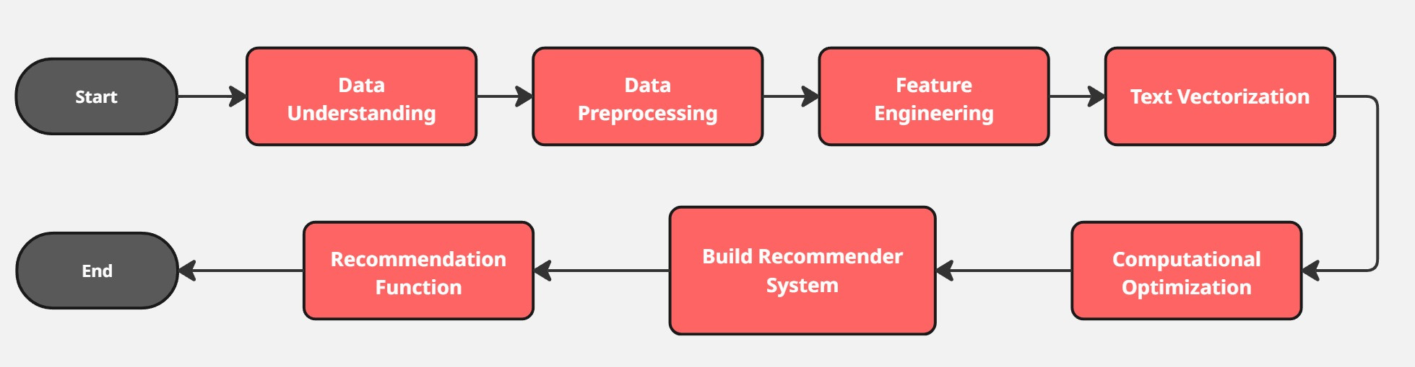
DATA SCIENCE | PROJECT 2025
FLOWCHART
View others project on my GitHub Repository: https://github.com/mfakhriazhar

Slide 7
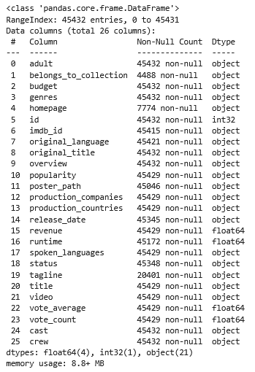
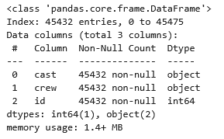
DATA SCIENCE | PROJECT 2025
DATA UNDERSTANDING
This dataset consists of the following files:
movies_metadata.csv: The main Movies Metadata file. Contains information on 45,000 movies featured in the Full MovieLens dataset. Features include posters, backdrops, budgets, revenues, release dates, languages, production countries, and companies.
credits.csv: Consists of Cast and Crew Information for all our movies. Available in the form of a stringified JSON Object.
Dataset link : https://www.kaggle.com/datasets/rounakbanik/the-movies-dataset#movies_metadata.csv%5B%5D(http://)
View others project on my GitHub Repository: https://github.com/mfakhriazhar

Slide 8
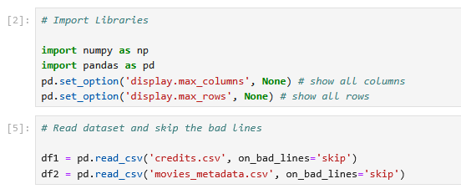
DATA SCIENCE | PROJECT 2025
IMPORT LIBRARIES AND LOAD DATASET
Import numpy for numerical operations and pandas for data manipulation and analysis using dataframe and series structures. [1]
Use pd.set_option() to configure pandas display settings on the data, here I set it to display all columns and rows in the dataset. [1]
Load datasets and skip problematic rows using on_bad_lines=’skip’. [2]
[1]
[2]
View others project on my GitHub Repository: https://github.com/mfakhriazhar

Slide 9
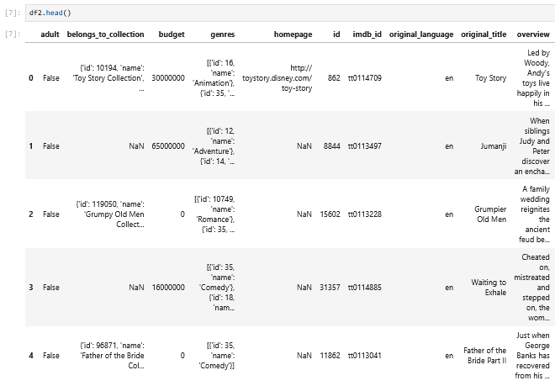
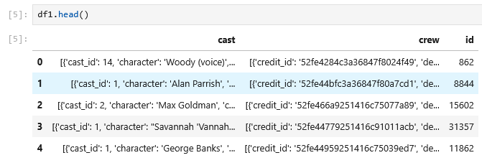
DATA SCIENCE | PROJECT 2025
DATA OVERVIEW
View others project on my GitHub Repository: https://github.com/mfakhriazhar

Slide 10
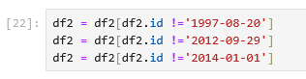
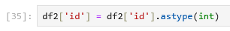
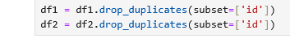
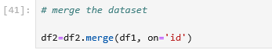
DATA SCIENCE | PROJECT 2025
DATA PREPROCESSING
[3]
Delete redundant data from the dataset. [3]
Convert the "id" column to integer type so that we can merge the two dataset files into one dataset. [4]
Drop duplicates so that all movies are unique and there are no duplicates. [5]
Merge dataset. [6]
[4]
[5]
[6]
View others project on my GitHub Repository: https://github.com/mfakhriazhar

Slide 11
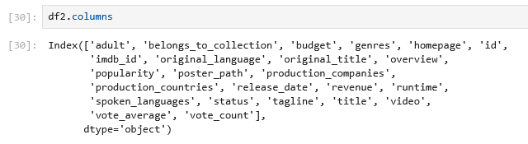
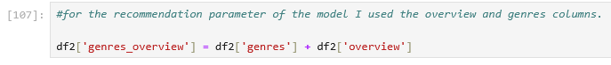
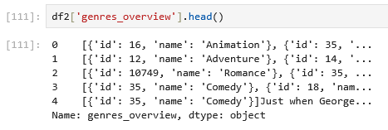
DATA SCIENCE | PROJECT 2025
FEATURES ENGINEERING
[7]
Display all columns in the dataset to select the key features to be used in the recommender system. [7]
Combine all key features that will be used in a new column. [8]
Key features overview. [9]
[8]
[9]
View others project on my GitHub Repository: https://github.com/mfakhriazhar

Slide 12
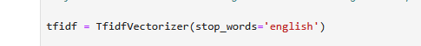
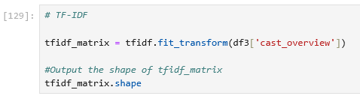
DATA SCIENCE | PROJECT 2025
TEXT VECTORIZATION
[10]
[11]
TF-IDF (Term Frequency-Inverse Document Frequency) is used to quantify the importance of words in a document.
Set up the vectorizer by importing the Tfidf Vectorizer from scikit-learn. [10]
Define the TfidfVectorizer object then remove all stopwords. [11]
Replace NaN with an empty string. [12]
Fit the dataset to the TfidfVectorizer object. [13]
[12]
[13]
View others project on my GitHub Repository: https://github.com/mfakhriazhar

Slide 13
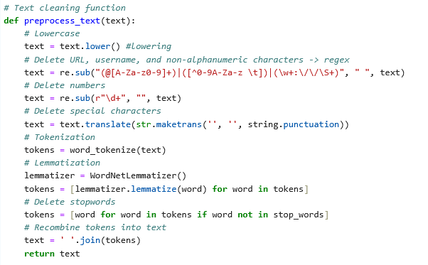
DATA SCIENCE | PROJECT 2025
TEXT PREPROCESSING
Lowercase: Converts text to lowercase to ensure uniformity. [14]
Removing numbers: Removes numerical values that do not contribute to meaning. [14]
Removing punctuation: Removes symbols and punctuation marks. [14]
Tokenization: Splits the text into words. [14]
Lemmatization: Converts words to their base form to standardize variations. [14]
Stop word removal: Removing common words that do not add meaningful information. [14]
Reconstructing text: Combines the cleaned words back into the processed text format. [14]
apply text preprocessing to the dataset. [15]
[14]
[15]
View others project on my GitHub Repository: https://github.com/mfakhriazhar

Slide 14
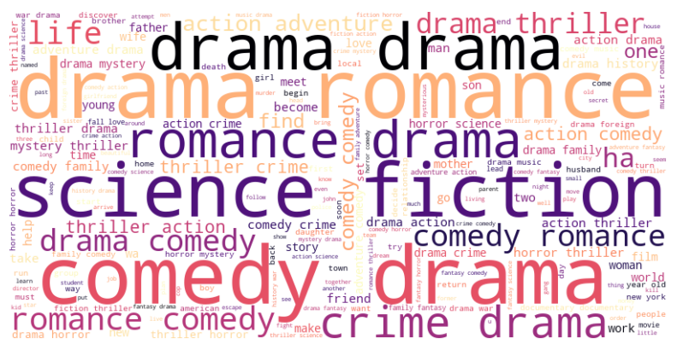
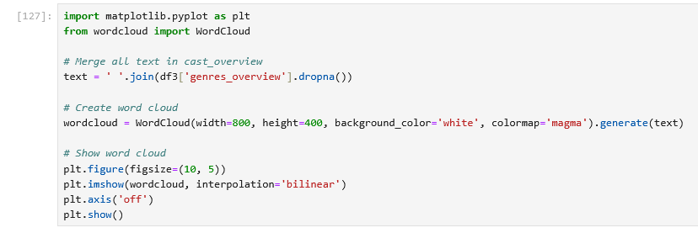
DATA SCIENCE | PROJECT 2025
EDA WORD CLOUD
EDA uses Word Cloud to help identify the most dominant movie genres and themes in the dataset, providing visual insights for initial understanding before building the recommendation model. [16]
The Word Cloud shows that words such as “drama,” “comedy,” “action,” “romance,” and “thriller” dominate, indicating that these genres appear most in the movie dataset. In addition, the words “science fiction,” “crime,” “adventure,” and “horror” are also quite prominent, enriching the variety of movie themes available to the recommendation system.
[16]
View others project on my GitHub Repository: https://github.com/mfakhriazhar

Slide 15
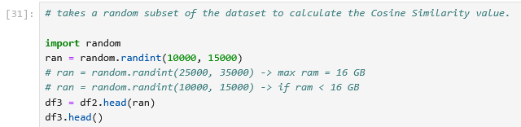
DATA SCIENCE | PROJECT 2025
COMPUTATIONAL OPTIMIZATION
The large dataset and limited computing power of this kernel caused frequent crashes while calculating the dot product for 45,000 movies. As a solution, I used a random subset of the data to calculate the Cosine Similarity value. [17]
[17]
View others project on my GitHub Repository: https://github.com/mfakhriazhar

Slide 16
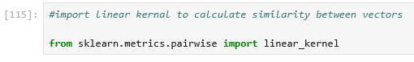
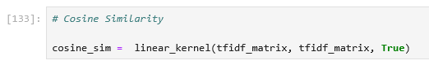
DATA SCIENCE | PROJECT 2025
RECOMMENDER SYSTEM (COSINE SIMILARITY)
[18]
create a recommendation system using cosine similarity with a linear kernel to calculate the similarity between vectors. [18]
View others project on my GitHub Repository: https://github.com/mfakhriazhar

Slide 17
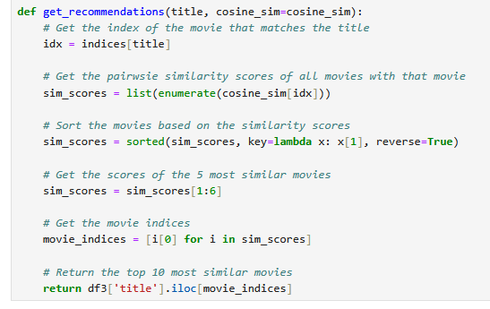
DATA SCIENCE | PROJECT 2025
GET RECOMMENDATION
Create a movie recommendation function based on a specific movie title input with:
similarity value of all movies with the movie [19]
sort movies by similarity value [19]
[19]
View others project on my GitHub Repository: https://github.com/mfakhriazhar

Slide 18


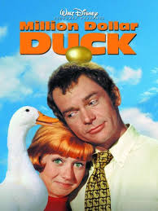
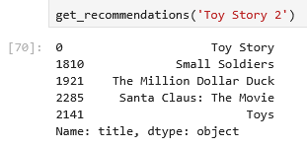

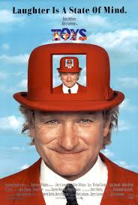
DATA SCIENCE | PROJECT 2025
RECOMMENDATION RESULT
View others project on my GitHub Repository: https://github.com/mfakhriazhar

Slide 19


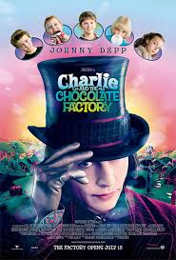
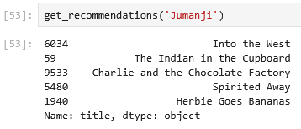


DATA SCIENCE | PROJECT 2025
RECOMMENDATION RESULT
View others project on my GitHub Repository: https://github.com/mfakhriazhar

Slide 20
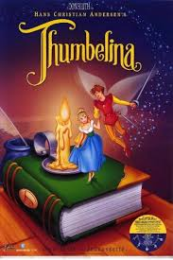
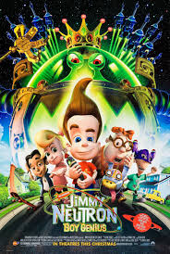
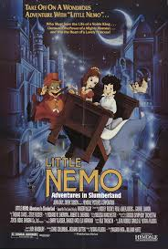
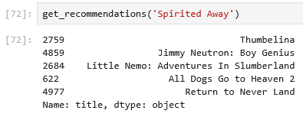
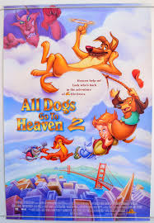

DATA SCIENCE | PROJECT 2025
RECOMMENDATION RESULT
View others project on my GitHub Repository: https://github.com/mfakhriazhar

Slide 21
DATA SCIENCE | PROJECT 2025
RECOMMENDATION RESULT ANALYSIS
The recommendation results generated are quite relevant to the movies in question.
For “Toy Story 2,” the suggested films such as “Toy Story” and “Toys” effectively align with the themes of animation and the toy world, making them strong choices.
Looking at the “Jumanji” recommendations, films like “Charlie and the Chocolate Factory” and “The Indian in the Cupboard” do encompass elements of adventure and fantasy, though there's some variability in the degree of similarity.
For “Spirited Away,” movies like “Thumbelina” and “Little Nemo” continue to resonate with the themes of animation, adventure, and imaginative exploration.
Overall, while the system has performed well with these recommendations, there may be opportunities to enhance the degree of similarity for certain titles, particularly with the adventure and fantasy genres.
View others project on my GitHub Repository: https://github.com/mfakhriazhar

Slide 22
DATA SCIENCE | PROJECT 2025
CONCLUSION
In this project, a content-based movie recommender system using movie data and credits has been successfully developed.
By preprocessing the text, combining important information, and applying TF-IDF and cosine similarity, the system is able to provide relevant movie recommendations based on the input movie title.
Simple evaluation results show that the recommendations are related to the theme or genre of the input movie.
Overall, this project proves that the content-based approach is effective for providing personalized movie suggestions without requiring user behavior data.
View others project on my GitHub Repository: https://github.com/mfakhriazhar

Slide 23




DATA SCIENCE | PROJECT 2025
About
Home
Contact
CONTACT
Contact Information
085724549367
mfkriazh57@gmail.com
Muhammad Fakhri Azhar
mfakhriazhar
View others project on my GitHub Repository: https://github.com/mfakhriazhar

Slide 24

DATA SCIENCE | PROJECT 2025
About
Home
Contact
THANK FOR YOUR ATTENTION
Muhammad Fakhri Azhar

